Slide 1

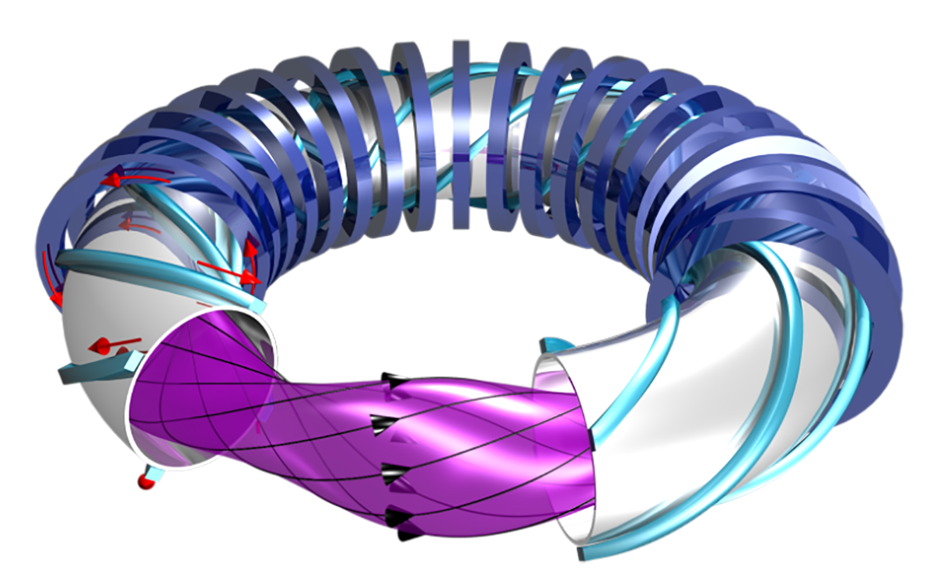
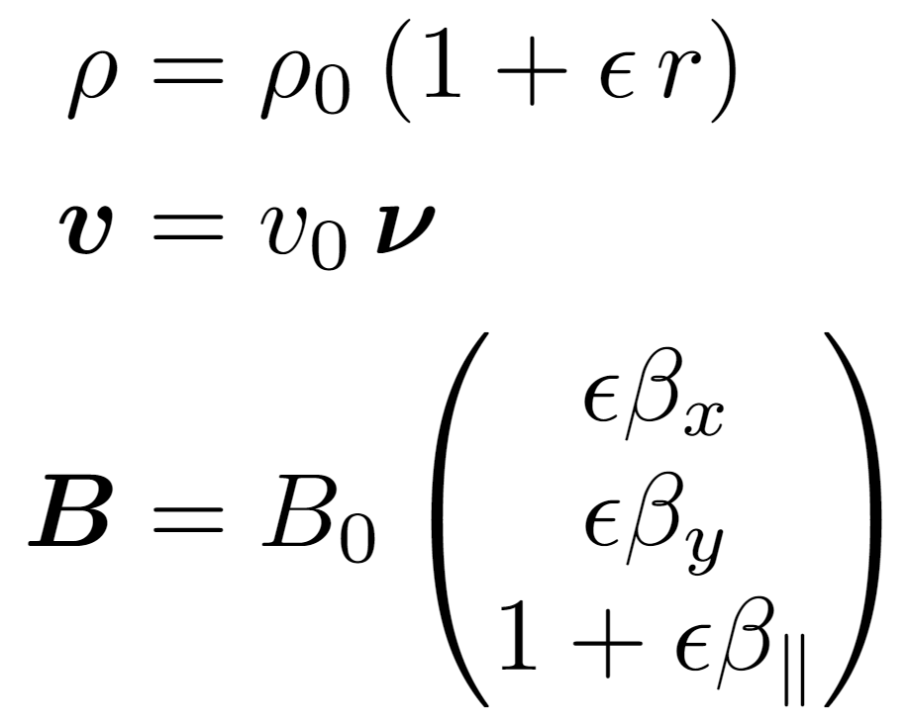
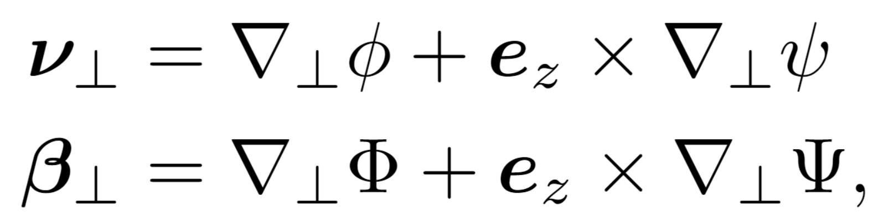
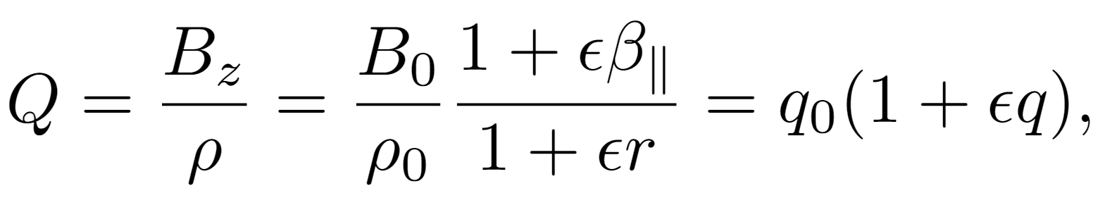
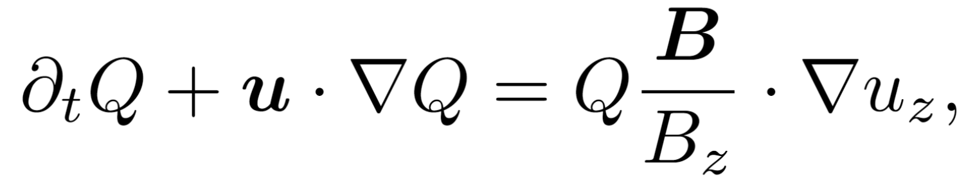
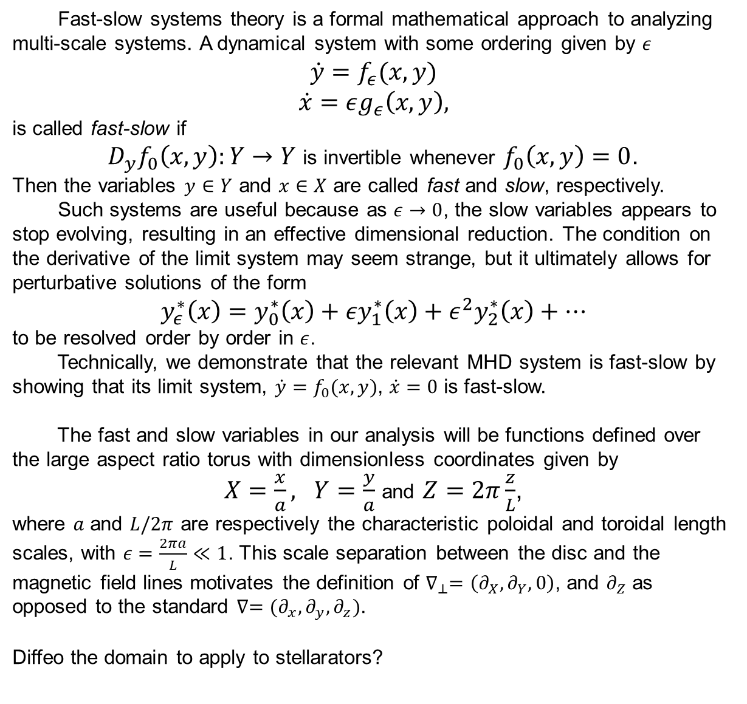
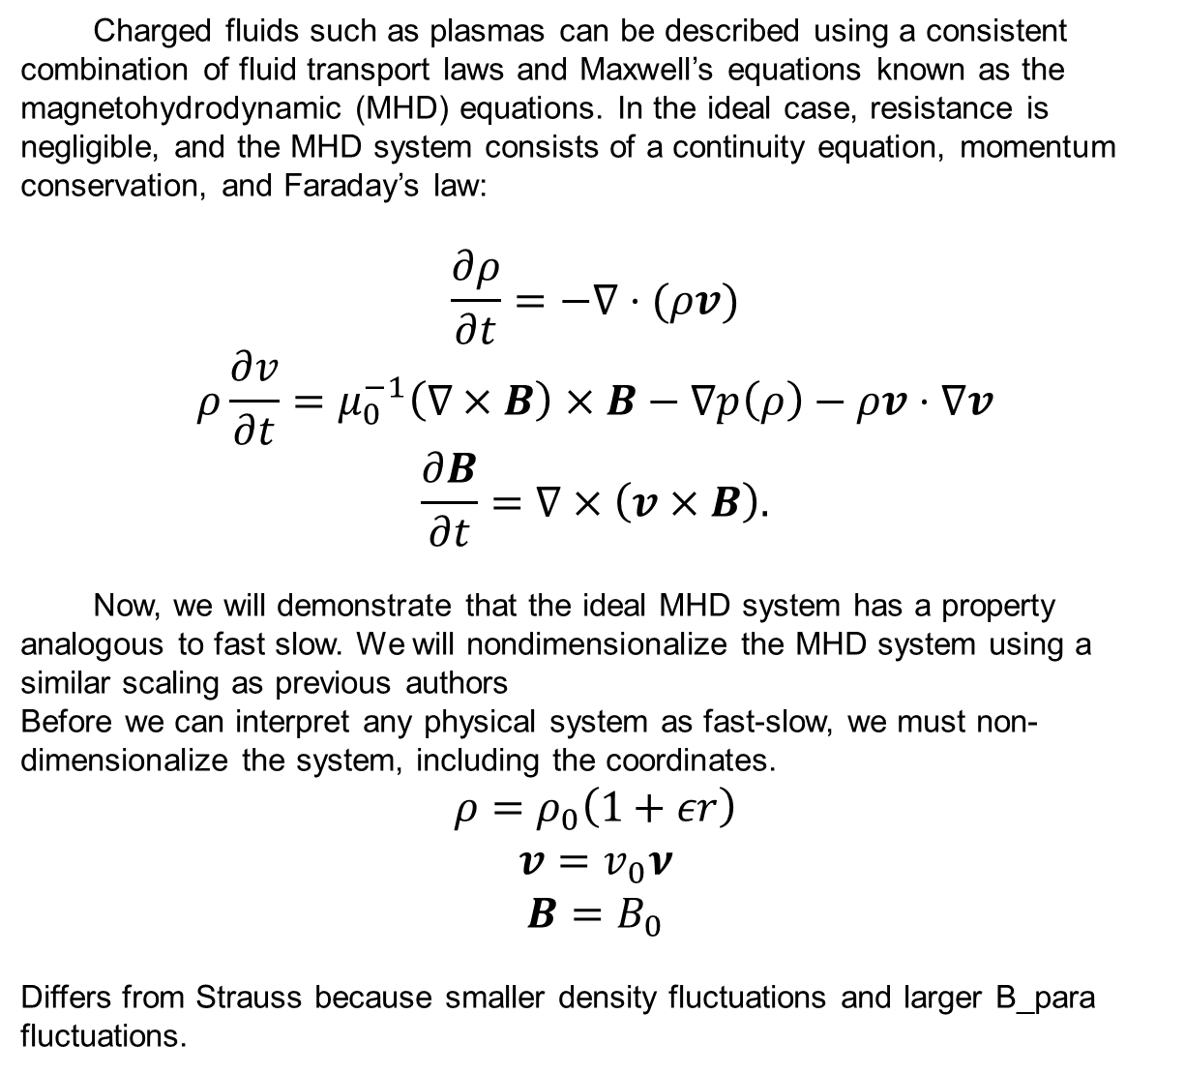
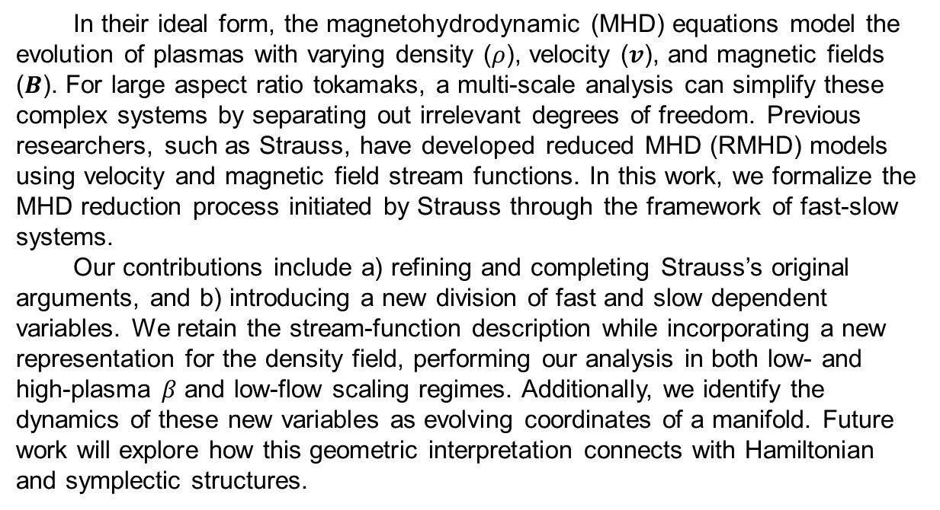
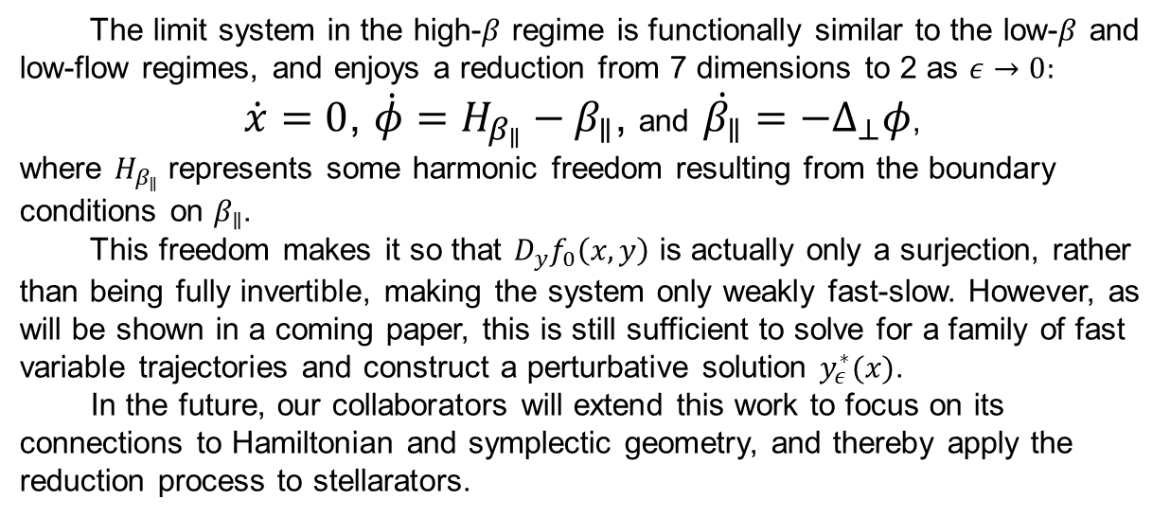
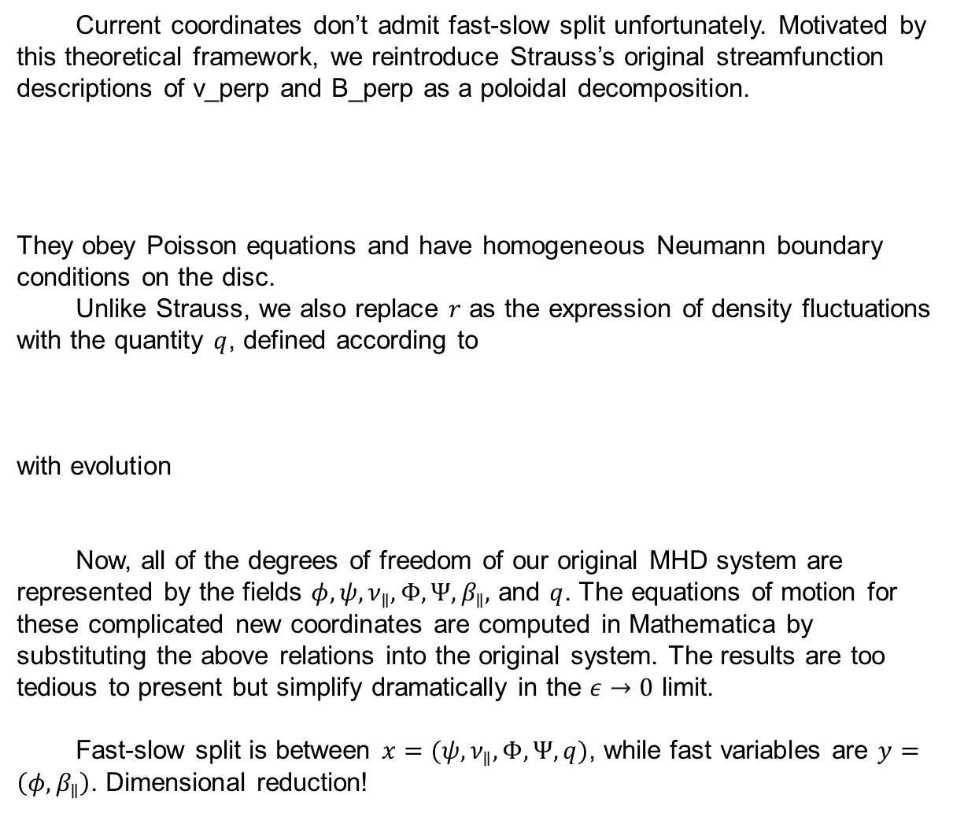
Formally Reducing the Large Aspect Ratio Magnetohydrodynamic Equations
Finny Valorz¹, Supervisor: Joshua Burby¹ ¹Department of Physics, College of Natural Sciences, The University of Texas
Introduction
MHD System and Scaling
Conclusion
In their ideal form, the magnetohydrodynamic (MHD) equations model the evolution of plasmas with varying density ($ρ$), velocity ($v$), and magnetic fields ($B$). For large aspect ratio tokamaks, a multi-scale analysis can simplify these complex systems by separating out irrelevant degrees of freedom. Previous researchers, such as Strauss, have developed reduced MHD (RMHD) models using velocity and magnetic field stream functions. In this work, we formalize the MHD reduction process initiated by Strauss through the framework of fast-slow systems.
Our contributions include a) refining and completing Strauss’s original arguments, and b) introducing a new division of fast and slow dependent variables. We retain the stream-function description while incorporating a new representation for the density field, performing our analysis in both low- and high-plasma $β$ and low-flow scaling regimes. Additionally, we identify the dynamics of these new variables as evolving coordinates of a manifold. Future work will explore how this geometric interpretation connects with Hamiltonian and symplectic structures.
Charged fluids such as plasmas can be described using a consistent combination of fluid transport laws and Maxwell’s equations known as the magnetohydrodynamic (MHD) equations. In the ideal case, resistance is negligible, and the MHD system consists of a continuity equation, momentum conservation, and Faraday’s law:
$$\frac{∂ρ}{∂t}=−∇⋅(ρv)$$
$$ρ\frac{∂v}{∂t}=μ_{0}^{−1}\left(∇×B\right)×B−∇p\left(ρ\right)−ρv⋅∇v$$
$$\frac{∂B}{∂t}=∇×\left(v×B\right).$$
Now, we will demonstrate that the ideal MHD system has a property analogous to fast slow. We will nondimensionalize the MHD system using a similar scaling as previous authors
Before we can interpret any physical system as fast-slow, we must non-dimensionalize the system, including the coordinates.
$$ρ=ρ_{0}\left(1+εr\right)$$
$$v=v_{0}ν$$
$$B=B_{0}$$
Differs from Strauss because smaller density fluctuations and larger B_para fluctuations.
Research Goal
https://www.iaea.org/bulletin/magnetic-fusion-confinement-with-tokamaks-and-stellarators
In this project, we carry out a dimensional reduction of the MHD equations by observing a fast-slow split. Reducing the typical tokamak equations this way is a necessary precursor for reducing MHD in general stellarator geometries.
The limit system in the high-$β$ regime is functionally similar to the low-$β$ and low-flow regimes, and enjoys a reduction from 7 dimensions to 2 as $ε→0$:
$\dot{x}=0$, $\dot{φ}=H_{β_{∥}}−β_{∥}$, and $\dot{β_{∥}}=−Δ_{⊥}φ$,
where $H_{β_{∥}}$ represents some harmonic freedom resulting from the boundary conditions on $β_{∥}$.
This freedom makes it so that $D_{y}f_{0}\left(x,y\right)$ is actually only a surjection, rather than being fully invertible, making the system only weakly fast-slow. However, as will be shown in a coming paper, this is still sufficient to solve for a family of fast variable trajectories and construct a perturbative solution $y_{ε}^{∗}(x)$.
In the future, our collaborators will extend this work to focus on its connections to Hamiltonian and symplectic geometry, and thereby apply the reduction process to stellarators.
Slow Manifold Reduction
Fast-slow systems theory is a formal mathematical approach to analyzing multi-scale systems. A dynamical system with some ordering given by $ε$
$$\dot{y}=f_{ε}(x,y)$$
$$\dot{x}=εg_{ε}\left(x,y\right),$$
is called fast-slow if
$D_{y}f_{0}\left(x,y\right):Y→Y$ is invertible whenever $f_{0}\left(x,y\right)=0$.
Then the variables $y∈Y$ and $x∈X$ are called fast and slow, respectively.
Such systems are useful because as $ε→0$, the slow variables appears to stop evolving, resulting in an effective dimensional reduction. The condition on the derivative of the limit system may seem strange, but it ultimately allows for perturbative solutions of the form
$$y_{ε}^{∗}\left(x\right)=y_{0}^{∗}\left(x\right)+εy_{1}^{∗}\left(x\right)+ε^{2}y_{2}^{∗}\left(x\right)+⋯$$
to be resolved order by order in $ε$.
Technically, we demonstrate that the relevant MHD system is fast-slow by showing that its limit system, ${\dot{y}=f}_{0}(x,y)$, $\dot{x}=0$ is fast-slow.
The fast and slow variables in our analysis will be functions defined over the large aspect ratio torus with dimensionless coordinates given by
$X=\frac{x}{a}, Y=\frac{y}{a}$ and $Z=2π\frac{z}{L}$,
where $a$ and $L/2π$ are respectively the characteristic poloidal and toroidal length scales, with $ε=\frac{2πa}{L}≪1$. This scale separation between the disc and the magnetic field lines motivates the definition of $∇_{⊥}=\left(∂_{X},∂_{Y},0\right)$, and $∂_{Z}$ as opposed to the standard $∇=(∂_{x},∂_{y},∂_{z})$.
Diffeo the domain to apply to stellarators?
Finding Fast-Slow Coordinates
Current coordinates don’t admit fast-slow split unfortunately. Motivated by this theoretical framework, we reintroduce Strauss’s original streamfunction descriptions of v_perp and B_perp as a poloidal decomposition.
They obey Poisson equations and have homogeneous Neumann boundary conditions on the disc.
Unlike Strauss, we also replace $r$ as the expression of density fluctuations with the quantity $q$, defined according to
with evolution
Now, all of the degrees of freedom of our original MHD system are represented by the fields $φ, ψ, ν_{∥}, Φ, Ψ, β_{∥},$ and $q$. The equations of motion for these complicated new coordinates are computed in Mathematica by substituting the above relations into the original system. The results are too tedious to present but simplify dramatically in the $ε→0$ limit.
Fast-slow split is between $x=(ψ,ν_{∥},Φ,Ψ,q)$, while fast variables are $y=\left(φ,β_{∥}\right)$. Dimensional reduction!
Acknowledgments
I would like to thank Joshua Burby for his guidance and support throughout this project. Thank you also to Ivan Maldonado, Michael Updike, Erik Hansen, and especially Finn Pinto for our insightful conversations.
References
H. R. Strauss. ‘Dynamics of high β tokamaks’, Phys. Fluids 20, 1354 (1977).
H. R. Strauss. ‘Nonlinear, three-dimensional magnetohydrodynamics of
noncircular tokamaks’, Phys. Fluids 19, 134 (1976).
J. W. Burby and T. J. Klotz. ‘Slow manifold reduction for plasma science,’ CNSNS
89, (2020).

